Slide 1
MongoDB
Spring Boot Cloud Foundry
Microservices
Notes:
last update: 4/3/2013

Slide 2
CAP Theorem
“Modern” apps require highly available distributed computing that can replicate changes across nodes
Cap Theorem States:
It is impossible for a distributed computer system to simultaneously provide all three of the following guarantees:
Consistency
All nodes see the same data at the same time
Achieved by updating several nodes before allowing reads
“traditionally” a 2-phase commit…
Availability
Every non-failing node returns a response for all read and write requests in a reasonable amount of time.
Achieved by replicating the data across different machines
Partition Tolerance
Operation continues despite arbitrary partitioning due to network failures
Latency due to re-routing…***
Take away – ACID properties are at risk of compromise
Notes:
https://en.wikipedia.org/wiki/CAP_theorem
ISSUE is when failure occurs [Partition tolerance]
a partition is any case in which the different nodes of a cluster can have communication interrupted without any node failing.
traditional ACID guarantees in mind such as RDBMS choose consistency over availability
whereas systems designed around the BASE philosophy, common in the NoSQL movement for example, choose availability over consistency

Slide 3
Basically Available, Soft state, Eventual consistency [BASE]
ACID ensures that at the point in time of the transaction [ACID] compliance is respected
BASE allows for ACID compliance to be temporarily violated as long as it eventually gets to a compliant end state.
NOSQL [Not Only SQL]
non-relational and largely distributed database systems
“thrives” in a CAP/BASE environment
Eventual Consistency:
At some point, all data sources will show the same data

Slide 4
Not Only SQL types
Key Value Store
“unstructured” data – “schema-less”
Document Store
Structured key value store based on organizing an entity as a document[ e.g JSON]
Column Store
Store based on column instead of row
Graph Base
Data represented as a graph.
Notes:
http://www.planetcassandra.org/what-is-nosql/

Slide 5
MongoDB
NOSQL Database
Document oriented
High performance, high availability, and easy to scale.
Alternative to relational database structure
JSON-based documents
Use Cases:
High Availability in an Unreliable Environment (RE:Cloud)
Plan to Grow Big [25+ GB]
You Don't have a DBA [ or don’t want one]
Large dataset – Regular “schema” changes
Works on concept of collection and document
Notes:
http://justmeteor.com/blog/why-we-dont-denormalize-anymore/
https://www.compose.com/articles/mongodb-with-and-without-schemas/
NON schema costly
https://stackoverflow.com/questions/6635718/how-to-work-around-the-lack-of-transactions-in-mongodb

Slide 6
MongoDB nomeclature
Document
questions: [
{ question: "How old are you?",
input: "number"
},
{ question: "Do you like our products?",
answers:
[ "Yes",
"No",
"Maybe“
]
}
]
Database
Database is a physical container for collections. Each database gets its own set of files on the file system. A single MongoDB server typically has multiple databases.
Collection
Collection is a group of MongoDB documents. It is the equivalent of an RDBMS table. A collection exists within a single database. Collections do not enforce a schema. Documents within a collection can have different fields. Typically, all documents in a collection are of similar or related purpose.
Document
A document is a set of key-value pairs. Documents have dynamic schema. Dynamic schema means that documents in the same collection do not need to have the same set of fields or structure, and common fields in a collection's documents may hold different types of data.
Notes:
Dynamic Schema:
https://docs.spring.io/spring-data/mongodb/docs/current/reference/html/#mongo.custom-converters
https://docs.spring.io/spring-data/data-mongodb/docs/current/reference/html/#mongo-template.type-mapping
http://stackoverflow.com/questions/23256507/how-to-store-dynamic-fields-in-mongo-db
questions: [
{ question: "How old are you?",
input: "number"
},
{ question: "Do you like our products?",
answers:
[ "Yes",
"No",
"Maybe“
]
}

Slide 7
Relational MongoDB Comparison
RDBMS | MongoDB
Database | Database
Table | Collection
Tuple/Row | Document
Column | Field
Table Join | Embedded Documents
Primary Key | Primary Key (Default key _id provided by mongodb itself)
Database Server and Client
Mysqld/Oracle | mongod
mysql/sqlplus | mongo
BigInteger; String
SQL-MongoDB Comparision
Notes:
By default when inserting documents in the collection, if you don't add a field name with the _id in the field name, then MongoDB will automatically add an ObjectId _id field as shown below
By default when using spring-data-mongodb, Spring uses a MappingMongoConverter to convert domain objects to/from document.
The following outlines what field will be mapped to the '_id' document field:
A field annotated with @Id (org.springframework.data.annotation.Id) will be mapped to the '_id' field. A field without an annotation but named id will be mapped to the '_id' field. The following outlines what type conversion, if any, will be done on the property mapped to the _id document field.
If a field named 'id' is declared as a String or BigInteger in the Java class it will be converted to and stored as an ObjectId if possible. ObjectId as a field type is also valid.

Slide 8
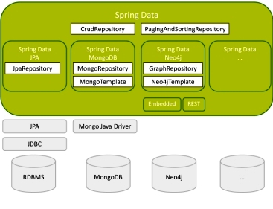
Spring Data Project
  High level Spring project whose purpose is to unify and ease the access to different kinds of persistence stores, both relational database systems and NoSQL data stores.
Notes:
https://en.wikipedia.org/wiki/NoSQL#Types_and_examples_of_NoSQL_databases

Slide 9
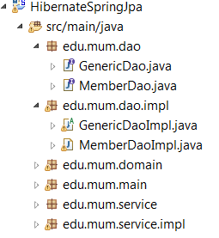
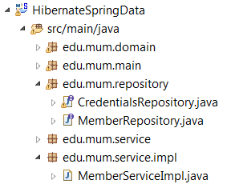
Spring Data
AUTO-GENERATES the DAO
No Need for GenericDAO,
etc.
@Repository
public class MemberDaoImpl extends GenericDaoImpl<Member> implements MemberDao {
public MemberDaoImpl() {
super.setDaoType(Member.class );
}
public Member findByMemberNumber(Integer memberNumber) {
Query query = entityManager.createQuery("select m from MEMBER m
where m.memberNumber =:number");
return (Member) query.setParameter("number", memberNumber).getSingleResult();
}
BECOMES
@Repository
public interface MemberRepository extends CrudRepository<Member, Long>
{
public Member findByMemberNumber(Integer memberNumber);
} See HibernateSpringData

Slide 10
Spring Data – MongoDB support
Follows Spring Data “Standard”
public interface ProductDao extends MongoRepository<Product,String> {
public Product findByName(String name);
}
Backed by MongoTemplate
<bean id="mongo" class="org.springframework.data.mongodb.core.MongoClientFactoryBean">
<property name="host" value="localhost" />
</bean>
** Config handled by Spring Boot
<bean id="mongoTemplate" class="org.springframework.data.mongodb.core.MongoTemplate">
<constructor-arg ref="mongo"/>
<constructor-arg name="databaseName" value="eacore"/>
</bean>
Generates JSON queries
e.g., @Query("{ ‘ name' : ?0 }")
Notes:
https://www.baeldung.com/queries-in-spring-data-mongodb
https://blog.marcnuri.com/spring-data-mongodb-custom-repository-implementation/
https://www.devglan.com/spring-boot/spring-data-mongodb-queries

Slide 11
Microservices
Organized around Business Capabilities
Independently deployable by fully automated “machinery”
Bare minimum of centralized management
Can be written in different programming languages and use different data storage technologies. [“polygot”]
If you’re spending significant time worrying about the difference between a service and a microservice, or the relationship between microservices and SOA, you are wasting your time.
Notes:
https://axispraxis.wordpress.com/2016/03/24/the-streetlight-effect-a-metaphor-for-knowledge-and-ignorance/
looking in the light, but under the wrong lamppost
Sufi;
“What have you lost, Mulla?” he asked. “My key,” said the Mulla. So they both went down on their knees and looked for it. After a time the other man asked: “Where exactly did you drop it?” “In my own house.” “Then why are you looking here?” “There is more light here than inside my own house.”‘
Noam Chomsky..
Science is a bit like the joke about the drunk who is looking under a lamppost for a key that he has lost on the other side of the street, because that’s where the light is. It has no other choice.”

Slide 12
Microservices are “Organizational’
"The Mythical Man-Month,“:
Conway’s law state that:
Any organization that designs a system (defined broadly) will produce a design whose structure is a copy of the organization’s communication structure.
Amazon – The two pizza team. You build it you own it…
Bad behavior arises when you abstract people away from the consequences of their actions

Slide 13
Microservices
…term “microservices” is in broad use – not much clarity on what it means.
Microservices are not about services and are not about being small.
Microservices are not about identifying a function that is common to multiple applications, and creating a single, shared deployment of that function.
Microservices are a way of dividing the implementation of a SINGLE application into a set of components.
What is it?
NOREST [ Not Only REST]
High Volume; Web based
“Dumb Pipe - Smart Endpoints”
Messaging
Notes:
https://www.infoq.com/news/2013/02/netflix-api-optimization
REST is synchronous & Bulky…
Messaging and or WebSockets better performing

Slide 14
Microservices
Benefits:
Costs:
Strong Module Boundaries: Microservices reinforce modular structure, which is particularly important for larger teams.
Independent Deployment: Simple services are easier to deploy, and since they are autonomous, are less likely to cause system failures when they go wrong.
Technology Diversity: With microservices you can mix multiple languages, development frameworks and data-storage technologies.
Distribution:
Distributed systems are harder to program, since remote calls are slow and are always at risk of failure.
Eventual Consistency: Maintaining strong consistency is extremely difficult for a distributed system, which means everyone has to manage eventual consistency.
Operational Complexity: You need a mature operations team to manage lots of services, which are being redeployed regularly.

Slide 15
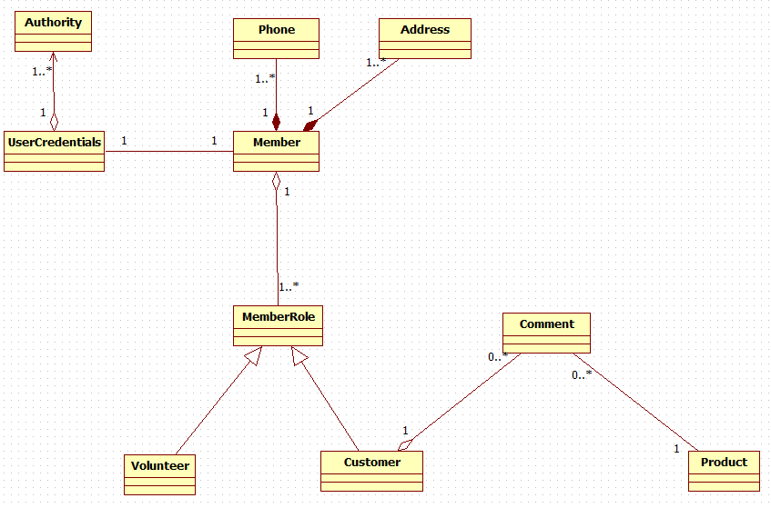
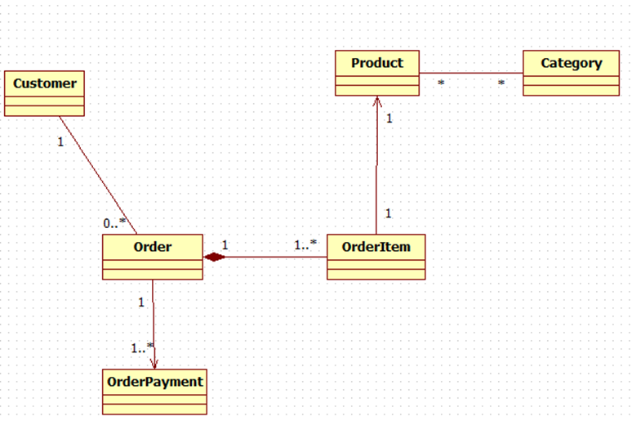
Target Application
Design Model
“possible”
Bounded Contexts

Slide 16
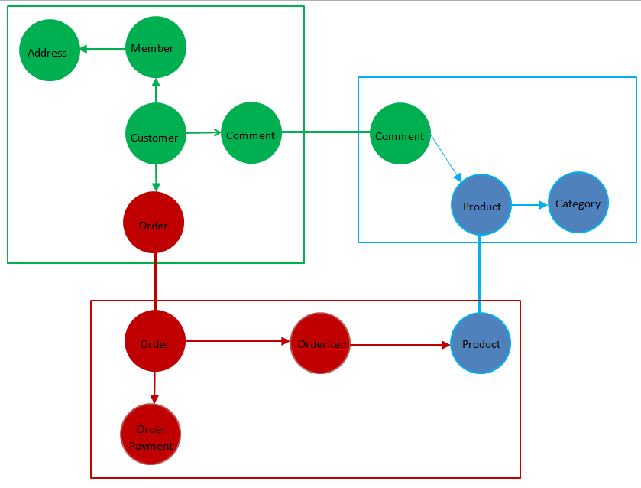
Bounded Context Model
Notes:
https://medium.com/@shijuvar/microservices-overview-misinterpretations-and-misuses-56a1979edafb
Aggregates .vs. bounded context

Slide 17




Component N-Tier
We introduced the concept of Bounded Context in Lesson 2a
We introduced REST & Isolated” Product in Lesson 12
Comment
Restful API
How About Splitting off the Product ?

Slide 18
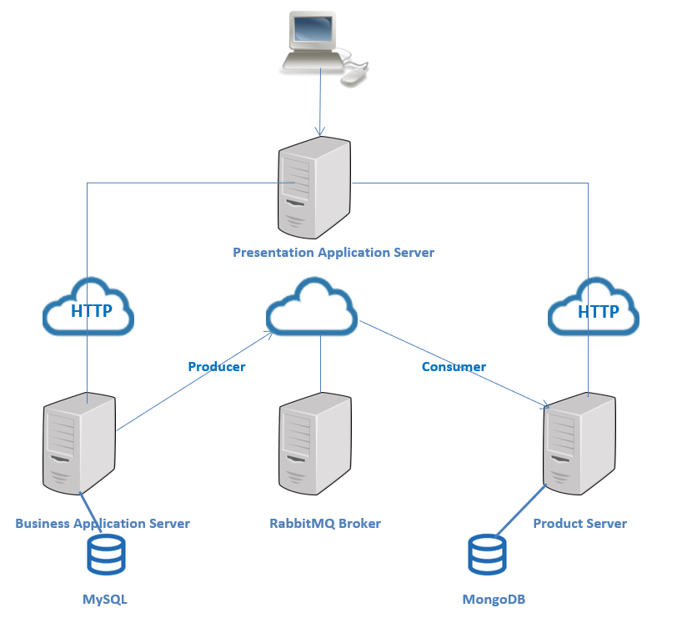
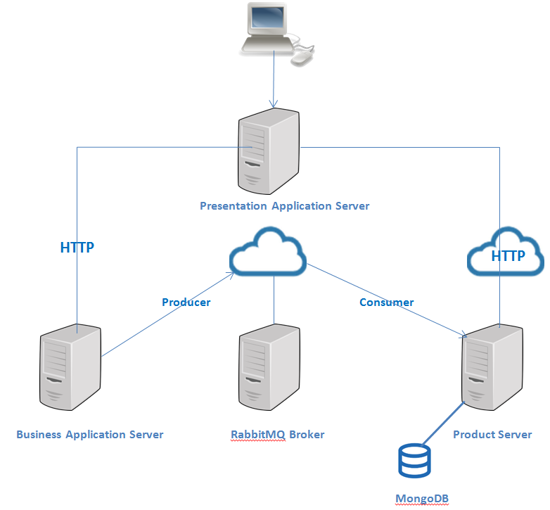
Cloud Deployment:
Product W/MongoDB & Member W/MySQL
Shared Bounded Context[Comment]
Rabbitmq Broker
Comment Exchange
Member
UserCredentials
Comment
Product[Partial]
Product
Comment
Member[Partial]
Notes:
See RestServers.docx for picture

Slide 19
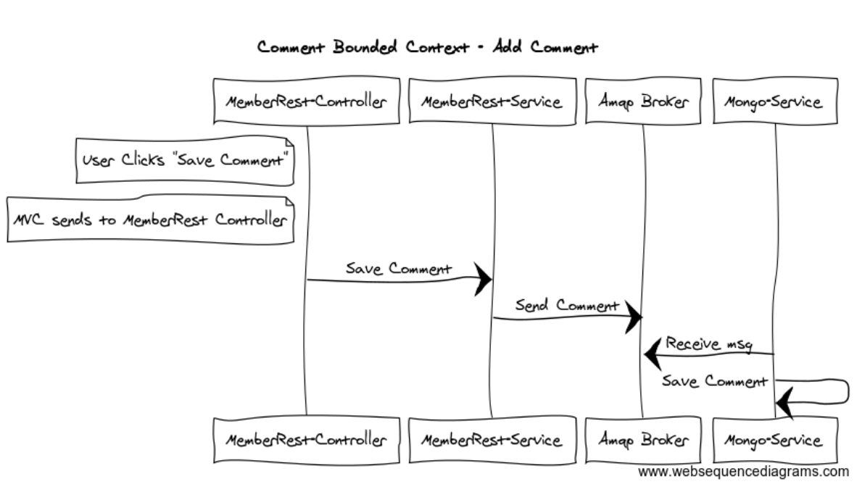
Bounded Context
Distributed Comment Save

Slide 20
Spring Cloud Netflix
Microservices Technologies
Service Discovery: Eureka instances can be registered and clients can discover the instances using Spring-managed beans
Service Discovery: an embedded Eureka server can be created with declarative Java configuration
Circuit Breaker: Hystrix clients can be built with a simple annotation-driven method decorator
Circuit Breaker: embedded Hystrix dashboard with declarative Java configuration
Declarative REST Client: Feign creates a dynamic implementation of an interface decorated with JAX-RS or Spring MVC annotations
Client Side Load Balancer: Ribbon
External Configuration: a bridge from the Spring Environment to Archaius (enables native configuration of Netflix components using Spring Boot conventions)
Router and Filter: automatic regsitration of Zuul filters, and a simple convention over configuration approach to reverse proxy creation
NetFlix Open Source Software

Slide 21
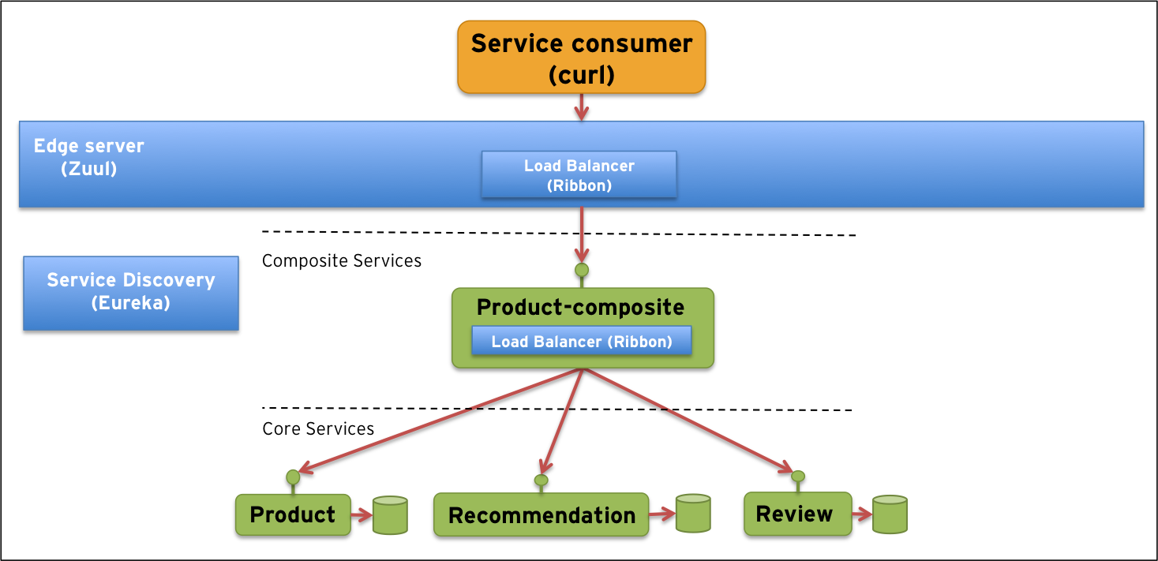
Sample Spring – Cloud – Netflix
Microservices
Demo Spring Cloud Services
Notes:
http://callistaenterprise.se/blogg/teknik/2015/04/10/building-microservices-with-spring-cloud-and-netflix-oss-part-1/
cURL is a command line tool for getting or sending files using URL syntax.

Slide 22
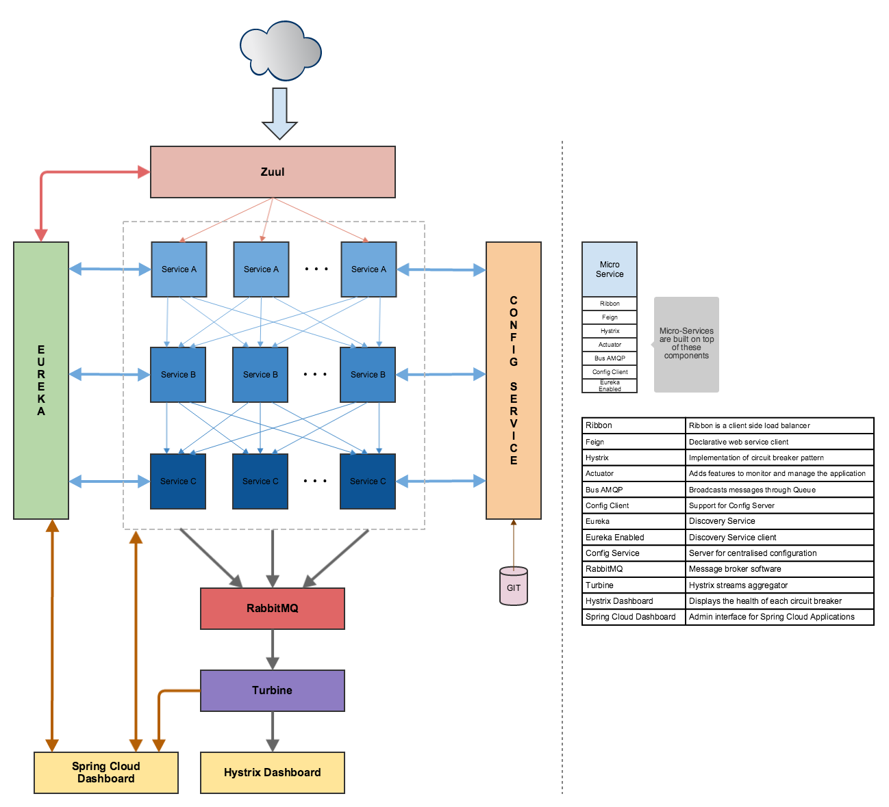
Another Sample
RISK:
Everything “looks” better from the small, simple component perspective…
What about the connectivity?!!??
Shifting complexity from component to connection…
…less explicit and harder to control.
!!!!!
Where the “rubber meets the road” !!!!!
Notes:
http://netflix.github.io/
Hystrix circuit breaker
Eureka registry
Zuul router API gateway [façade] uses registry …Ribbon does load balancing

Slide 23
Microservices Development Approach
Begin with the monolith, refactor, make it modular – Understand your
Design/Implementation/Dependencies
Split it into microservices where the monolith is a bottleneck..
Add new features by building microservices that use the monolith's API.
“Low Hanging Fruit” Use Cases:
Features that are inherently temporary, such as specialized pages to handle a
Special sale/event.
New services for a market opportunity and discarded after a
few months or even weeks.
Notes:
Do NOT start with a microservices architecture.
Migration example
https://www.youtube.com/watch?v=Tx5h3hdvjfw

Slide 24
CLI Access to Cloud Resources

Slide 25
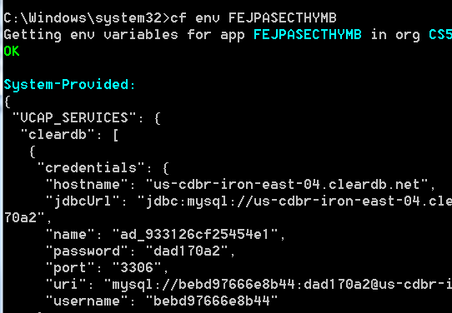
Set up MySQLAdmin
Notes:
HOST: us-cdbr-iron-east-04.cleardb.net
Username : bebd97666e8b44
Pass: dad170a2

Slide 26
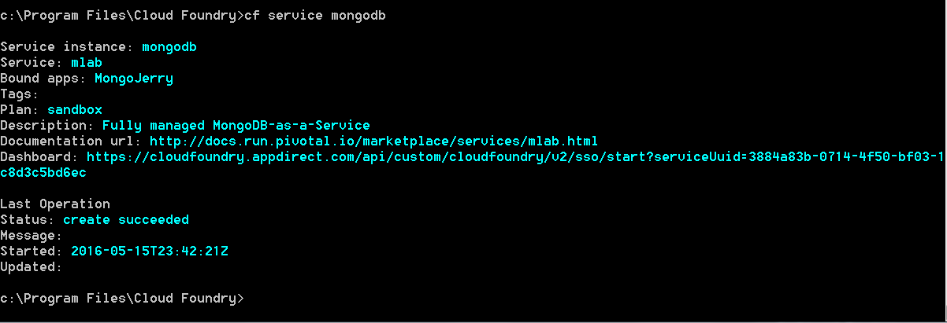
Access CLOUD mongodb instance
Dashboard URL for Instance access:
Notes:
Dashboard: https://cloudfoundry.appdirect.com/api/custom/cloudfoundry/v2/sso/start?serviceUuid=3884a83b-0714-4f50-bf03-1c8d3c5bd6ec

Slide 27
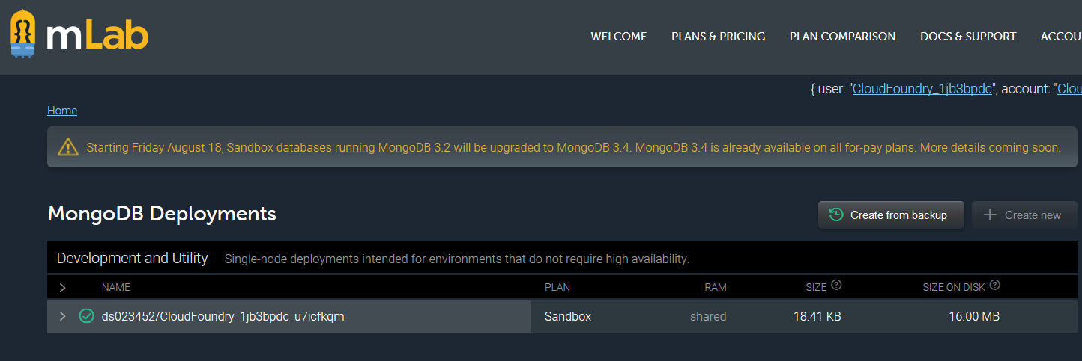
Go to Dashboard URL [Cut from CMD – paste in Browser]
Double click on DB

Slide 28
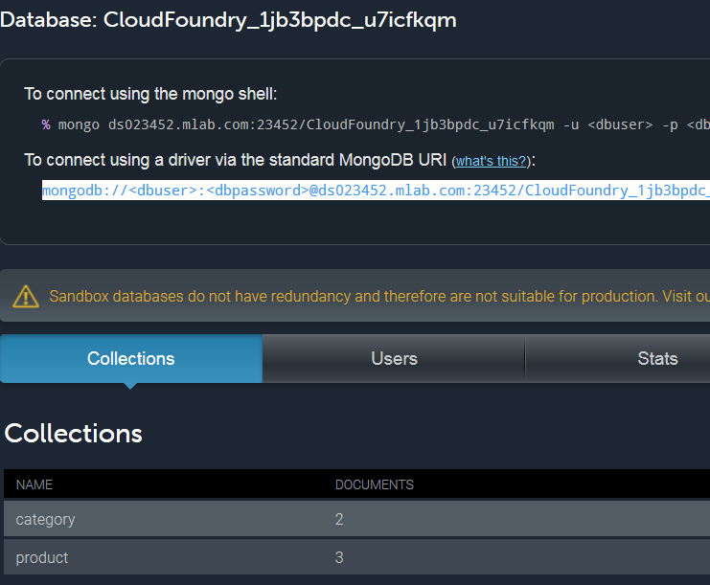
Double click on
Collection
[category]

Slide 29
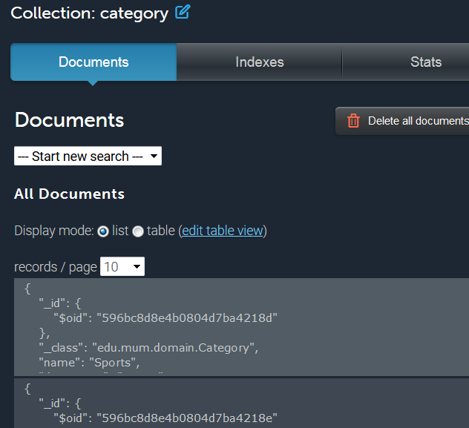

Slide 30
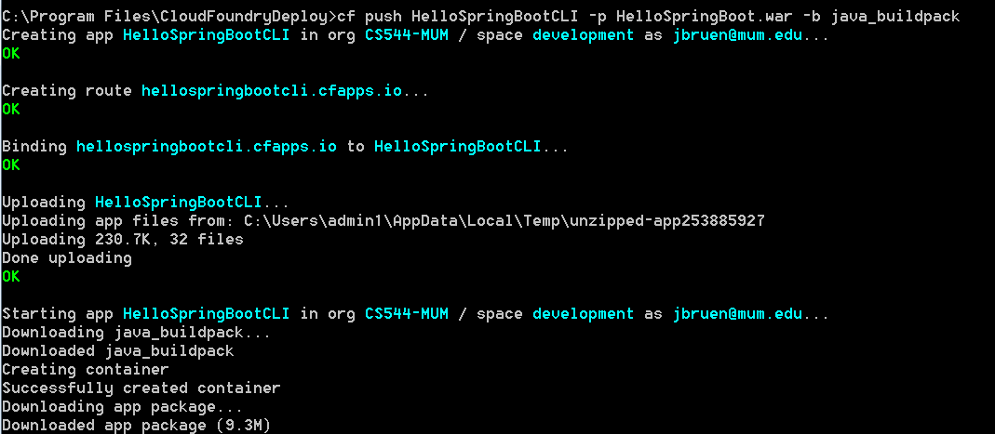
Deploy WAR to Cloud Foundry
Moved WAR to C:\Program Files/CloudFoundry
Actual command used is:
cf push “name to give app” –p [find by path] “path/war name”
-b “build pack” -- dependency & configuration management
Notes:
Cf push HelloSpringThymeBoot –p HellSpringThymeBoot.jar

Slide 31
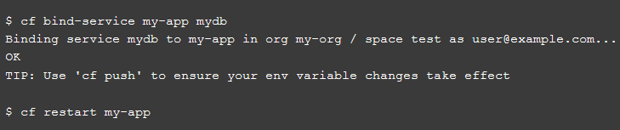
CLI Bind service to app

Slide 32
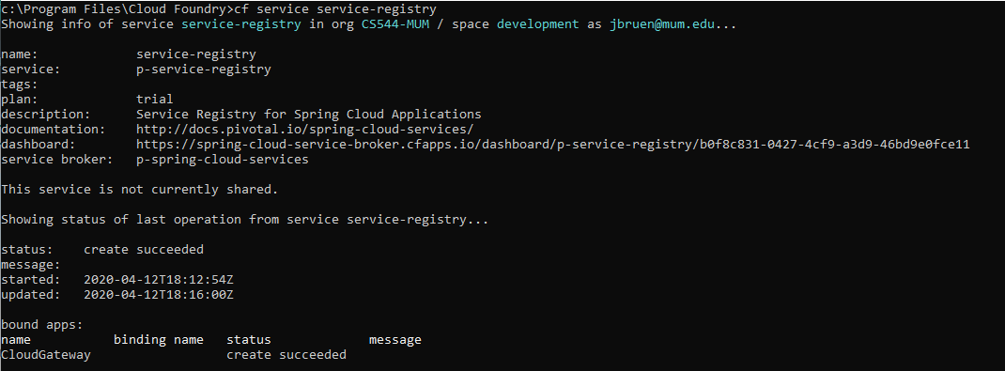
PWS provided EUREKA registry

Slide 33
CLOUD AMQP Setup
Add cloudampq in STS
Use plan Lemur [free]
From pivotal services login YOU can access Rabbit admin:
From “HOME”
Click on org name [cs544-MUM]
Click on development [space]
Click on MongoJerryBound
Click on Services
Click on cloudamqp
Click on manage
Click on RabbitMQ Manage…[upper left]
THERE YOU ARE!!!

Slide 34
The END

